Slide 1


Session 1. T24 Overview and Product Architecture
Transact (T24) Technical Induction Training
Minsk, 2021

Slide 2




Agenda
T24 Overview: features, advantages. T24 Model Bank
T24 Traditional Product Architecture and Product Architecture of AA Module
Types of User Interfaces

Slide 3
Agenda
T24 Overview: features, advantages. T24 Model Bank
T24 Traditional Product Architecture and Product Architecture of AA Module
Types of User Interfaces

Slide 4
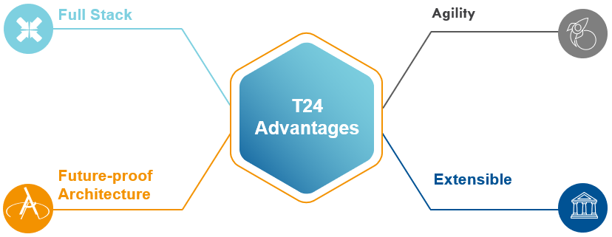

T24 Overview: features, advantages

Slide 5
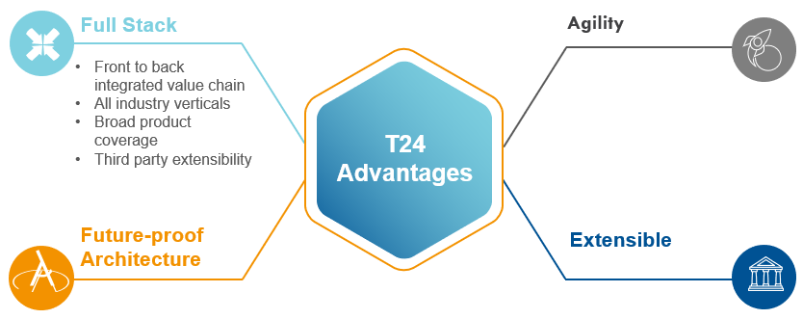
T24 Overview: features, advantages

Slide 6
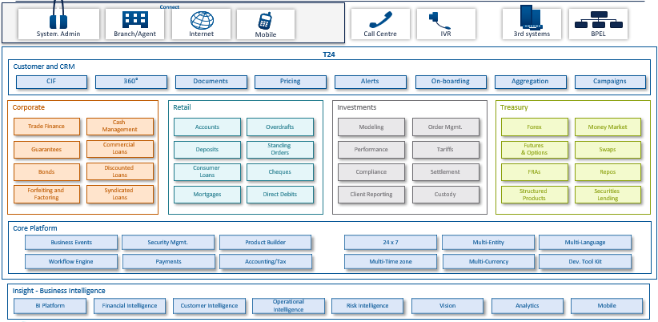
T24 Functional Architecture

Slide 7
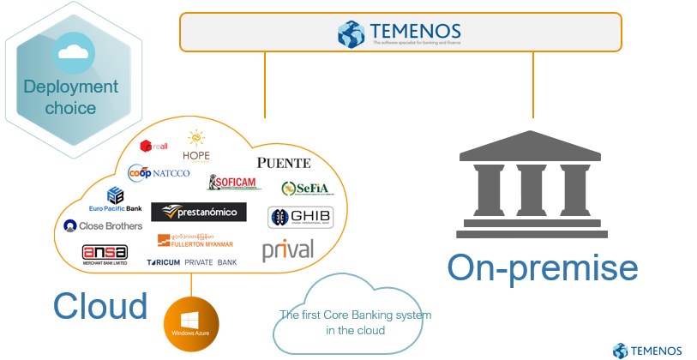
Available on cloud or on-premise

Slide 8
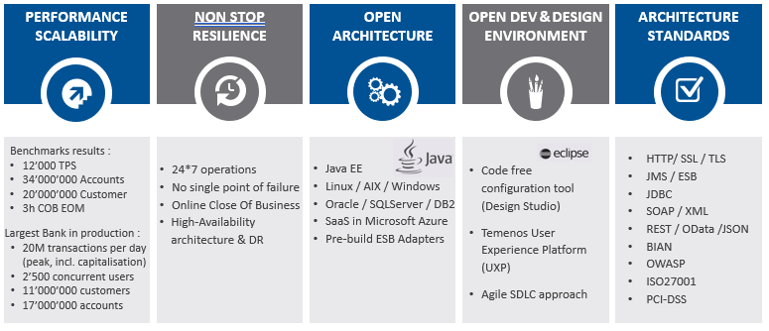
Technical Highlights

Slide 9
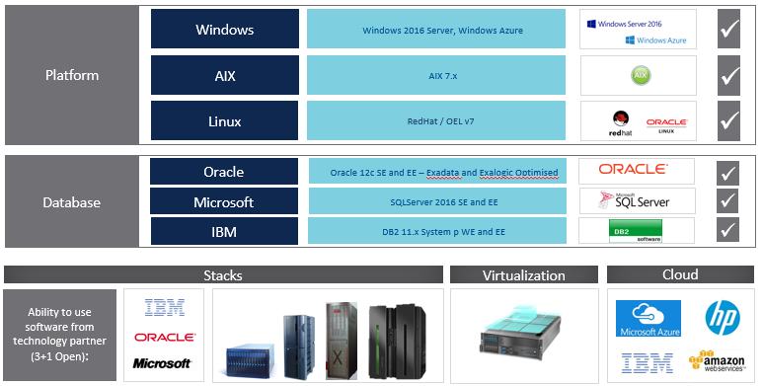
Platform and Database Independence

Slide 10
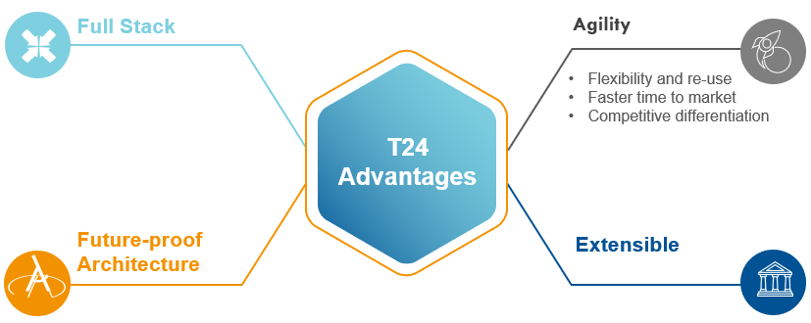
T24 Overview: features, advantages

Slide 11
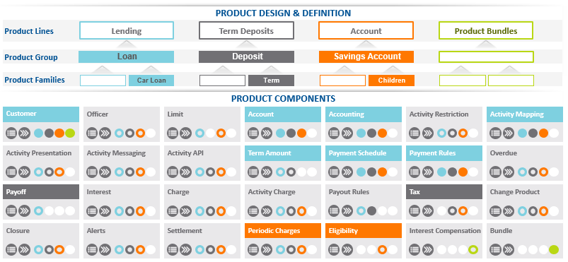
Product Agility: Innovative & Customisable Product Engine

Slide 12
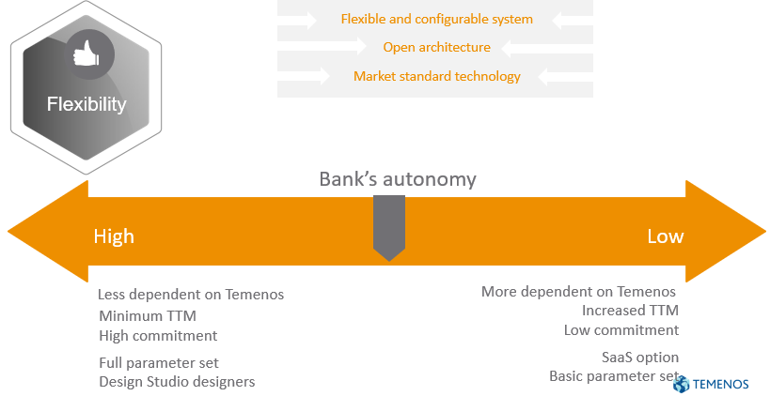
Full spectrum of autonomy
Notes:
SaaS — Software as a service

Slide 13
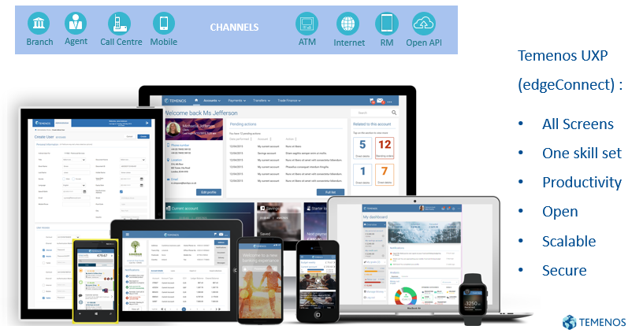
Temenos Channel - Multiple Products …One Brand Experience

Slide 14
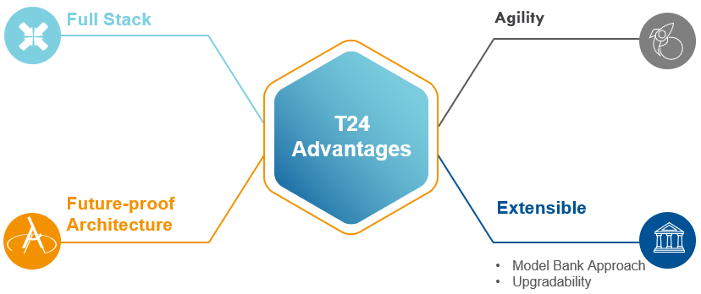
T24 Overview: features, advantages

Slide 15
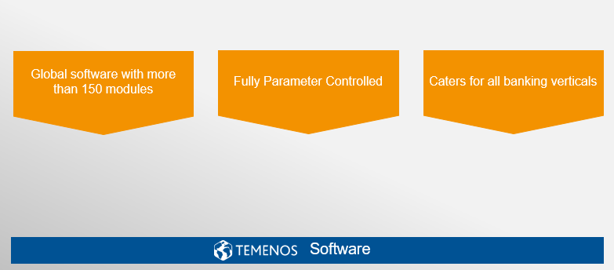
Model Bank layered approach

Slide 16
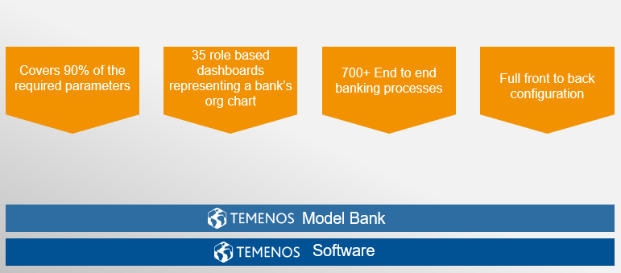
Model Bank layered approach

Slide 17
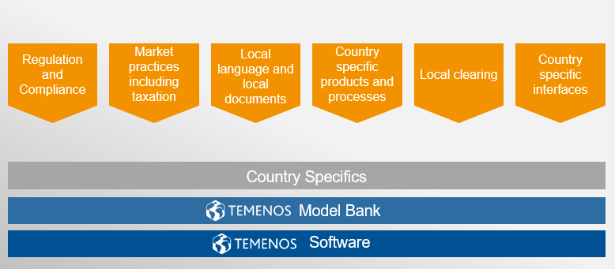
Model Bank layered approach

Slide 18
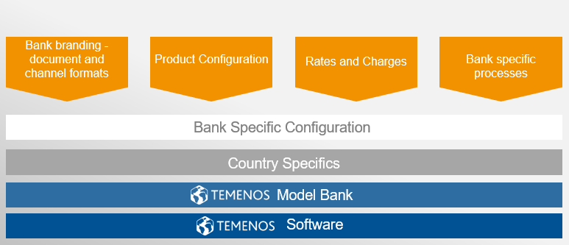
Model Bank layered approach

Slide 19
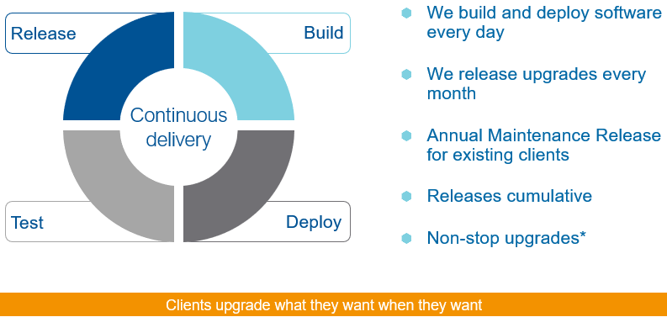
Continuous Delivery with Partial Upgrades

Slide 20
Agenda
T24 Overview: features, advantages. T24 Model Bank
T24 Traditional Product Architecture and Product Architecture of AA Module
Types of User Interfaces

Slide 21
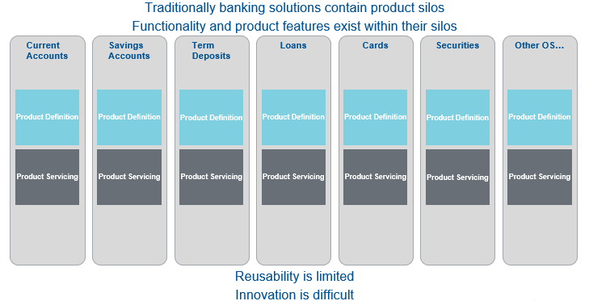
Traditional Product Architecture

Slide 22
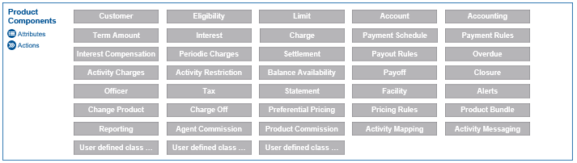
Product Architecture of AA Module
Product design and servicing are enterprise level functions
Business functionality is encapsulated in a set of common product components

Slide 23
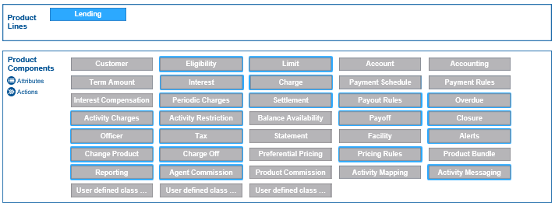
Product Architecture of AA Module
Product Lines are constructed by combining components

Slide 24
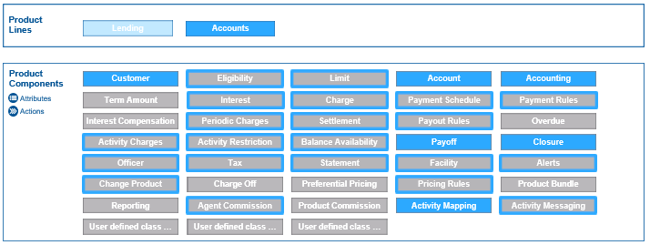
Product Architecture of AA Module
Different Product Lines are constructed by differing combinations of components

Slide 25
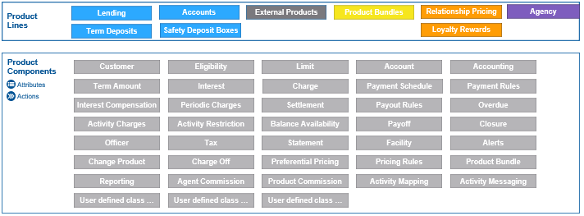
Product Architecture of AA Module
A wide variety of product lines can be built from this common set of components

Slide 26
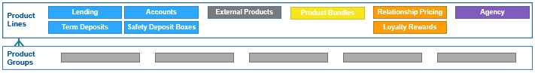
Product Architecture of AA Module
Product Lines can be subdivided into Product Groups allowing banks to define differing characteristics / behaviour for each group

Slide 27
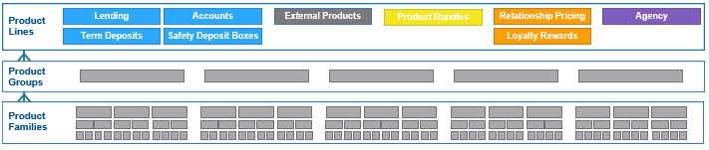
Product Architecture of AA Module
Product Families can then be created within each group
This provides for inheritance between a product and its parent thereby allowing new products to be created by simply defining how they differ from their parent
Product maintenance becomes easier as changes to a parent will be automatically inherited by child products

Slide 28
Arrangement Architecture - Key benefits
Componentization
Flexible definition of reusable components, product families and products with inheritance
Product Designer
Central product design capability for all product lines
Product Proofing & Publishing
Controlled product lifecycle management
Product Catalogue
Centralization of products/services offered by the bank

Slide 29
Arrangement Architecture - Key benefits
Activity Based
Effective dated business-oriented activities with complete activity log
Negotiation Rules
Controlled, parameter-driven contract personalization
Simulations
Accurate depiction of future arrangement events
Soft Accounting
Design bank-specific accounting rules per product group / family / specific product

Slide 30
Arrangement Architecture - Key benefits
Activity Restrictions
Controlled transaction / event processing on arrangements
Periodic Attributes
Time-controlled parameter-driven restrictions on products
Product Availability
Enables promotional products with set
timeframe
Product Eligibility
Establishing products available only to selected customers or groups

Slide 31
Agenda
T24 Overview: features, advantages. T24 Model Bank
T24 Traditional Product Architecture and Product Architecture of AA Module
Types of User Interfaces

Slide 32
Classic, Desktop, Browser, UXP
Т24 Classic (Terminal) – old type of user interface. Nowadays it is used for development and administration purposes
Т24 Desktop – old type of user interface. Nowadays it is not used. It required to be setup on user’s working area
T24 WEB Interface – type of user interface which use internet browser to reach environment.
UXP Browser – type of user interface that is used nowadays. It has much wider functionality than other user interfaces

Slide 33
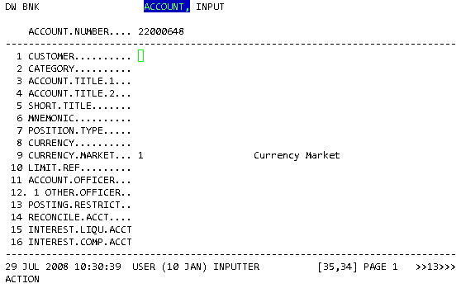
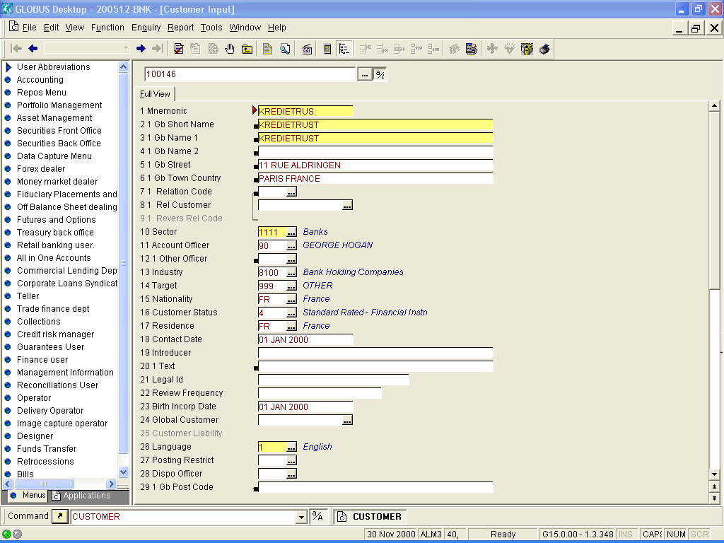
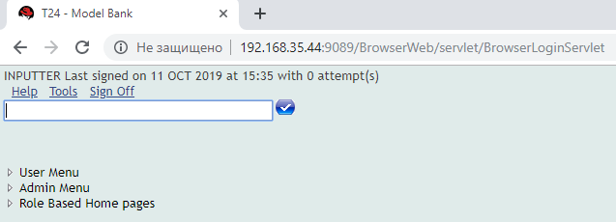
Classic, Desktop, Browser, UXP

Slide 34
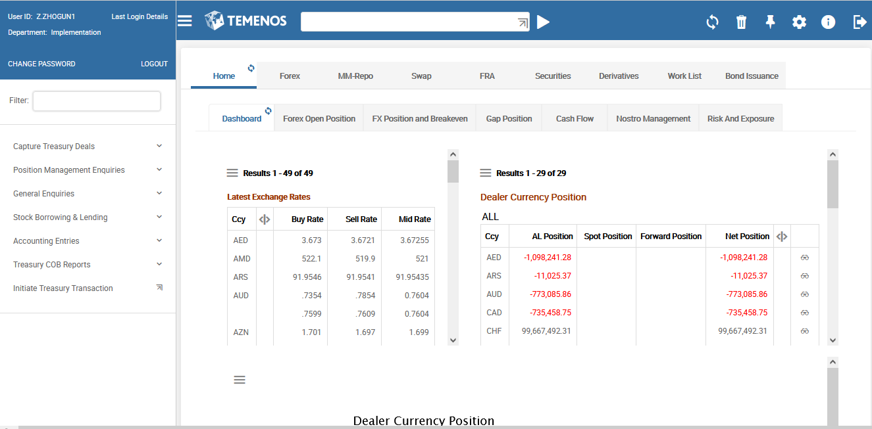
UXP Browser

Slide 35
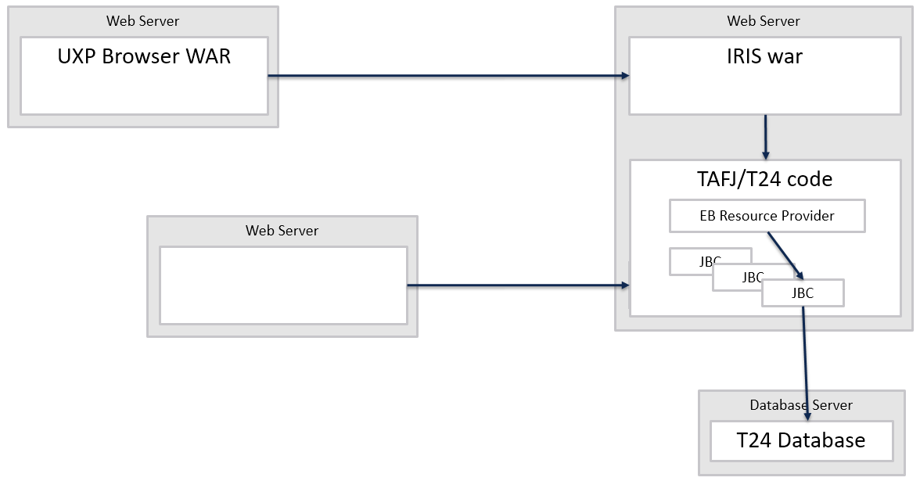
UXP Browser — Data Flow
Old BrowserWeb

Slide 36
UXP Browser — Data Flow
Modernised look and feel
Extended Customisation
User preferences for font sizes, width utilisation
Fast searchable menus
Version screens now adapt to available screen size (Responsive)
Slicker error message navigation and remediation
Ability to work with third-party systems
Multi-lingual Help-Text
Enhanced Export Features

Slide 37
Thank you for your time and attention!
FORANX LLC
Legal address:
35A, Ponomarenko str., 201 office, Minsk, 220015, Belarus
Tel.:+ 375 17 202 76 78
+ 375 17 202 76 79
Fax: + 375 17 362 34 22
Web-site: www.foranx.by
Minsk, 2021

